Slide 1
Recursion
-Ricky Mutschlechner

Slide 2
Divide et Impera
Also known as Divide and Conquer, a very common “Algorithm” to solving things in the real world, such as finding a number in the phonebook – you keep splitting the phonebook in half until you eventually find the right name/number.

Slide 3
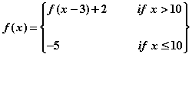
Piecewise Functions
In math, this is a very simple function. Simply put, if x is less than or equal to 10, you simply get -5 as your answer; however if x is greater than 10, you have to plug “x” back in, but subtract that by 3, and then add 2 to the value of the function (as shown above).

Slide 4
Piecewise Functions Cont.
^ The same piecewise function from the last slide, now if you wanted to translate this into java, you would do something like this:
Public static int fOf(int x){ //function method
if(x <= 10) // “base case” return -5;
else{
return fOf(x – 3) + 2; //recursive call
}

Slide 5
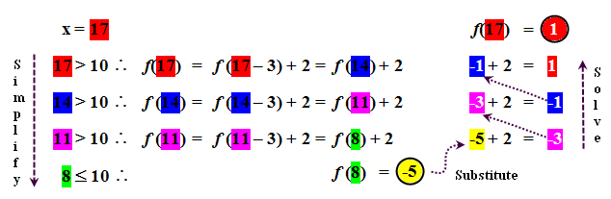
“SSS” Method
You can find the answer to a Piecewise function by using the S-
You can find the answer to a Piecewise function by using the S-S-S algorithm: Simplify, Substitute, and Solve.
• Simplify the expression through a series of intermediate calculations (as shown on
the left) until the base case is reached.
• Substitute the base case in the last unsolved expression.
• Solve the remaining unsolved expressions until the final answer is found.

